Slide 1
Data Product Manager Nanodegree
Applying Data Science to Product Management
Final Project: Developing an MVP Launch Strategy for a Flying Taxi Service

Slide 2
Welcome to your first week at Flyber

Slide 3


Slide 4
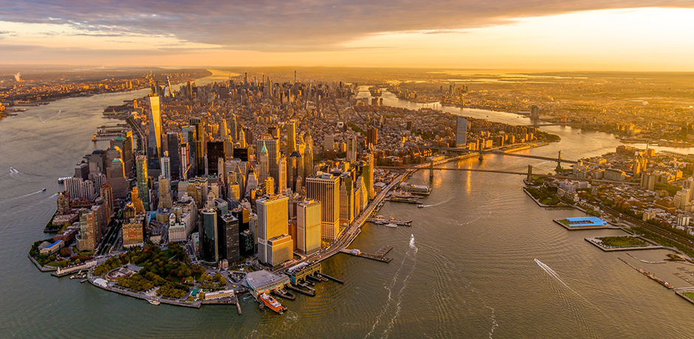
The Future in New York City
Picture yourself on a boat looking at Manhattan Finance District in 2030.
Focus on:
The coastal road surrounding the district
The bridges connecting the district to mainland – remember Manhattan is an island
Population density
Financial importance of the Financial District, for the United states and the world

Slide 5
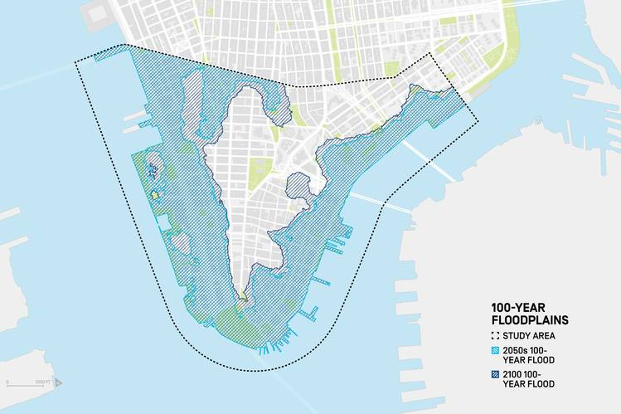
The Future in New York City
Picture yourself on a boat looking at Manhattan Finance District in 2030.
Focus again on:
The coastal road surrounding the district
The bridges connecting the district to mainland – remember Manhattan is an island
Population density
Financial importance of the Financial District, for the United states and the world

Slide 6

The Future in New York City
SUMMARY OF FINDINGS
This study’s findings demonstrate a need to protect the District comprehensively from a wide range of climate hazards – not only low frequency, extreme events, but also high frequency, lower intensity events and chronic conditions.
Impacts are organized by the climate hazards of storm surge, tidal inundation, groundwater table rise, extreme precipitation, and heat waves, and by the timeframes of 2050s and 2100.
The analysis shows that Lower Manhattan is at risk of multiple types of flooding due to both climate events and chronic conditions. Adapting the District requires a comprehensive approach, tackling hazards with a wide range of solutions that are explored in following chapters.

Slide 7
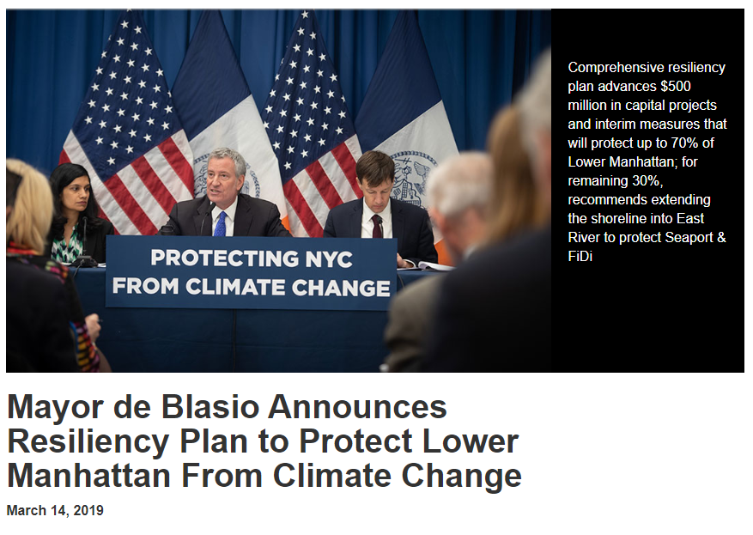
The Future in New York City Prepare for the Inevitable
“Hurricane Sandy showed us how vulnerable areas like Lower Manhattan are to climate change,” said Mayor de Blasio. “That’s why we not only have to reduce emissions to prevent the most cataclysmic potential effects of global warming, we have to prepare for the ones that are already inevitable. Our actions will protect Lower Manhattan into the next century. We need the federal government to stand behind cities like New York to meet this crisis head on.”
https://www1.nyc.gov/office-of-the-mayor/news/140-19/mayor-de-blasio-resiliency-plan-protect-lower-manhattan-climate-change

Slide 8
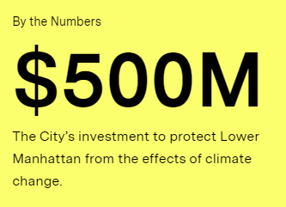
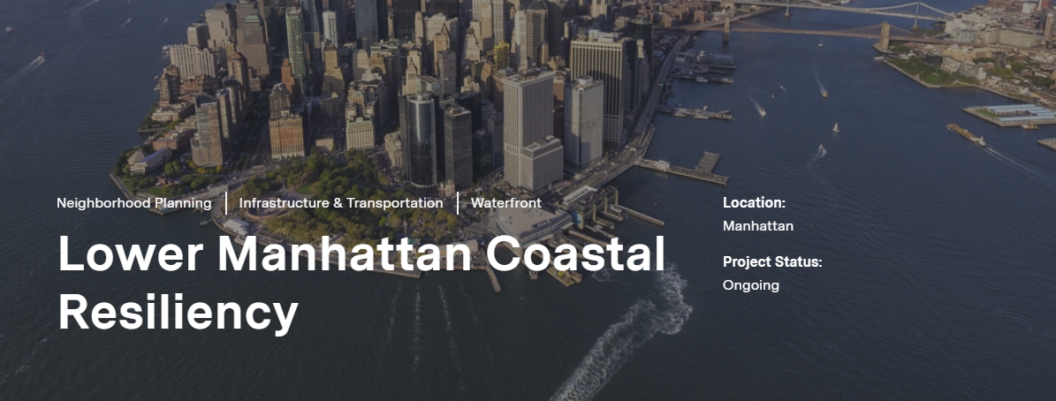
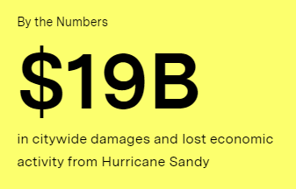
The Future in New York City Be part of the process
Climate change is the greatest threat New York City faces today. In October 2012, Hurricane Sandy hit New York City, flooding 17% of the city’s land, and claiming 44 lives. In Lower Manhattan alone, the impact of Hurricane Sandy was devastating, causing two deaths, damaging thousands of homes and interrupting a critical transportation hub.

Slide 9
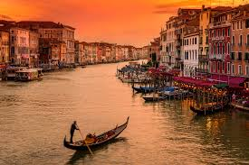
The Future in New York City
Looks familiar, however alternative transportation methods have yet to be adopted.

Slide 10
Bill de Blasio New York City Mayor on Budget for the fiscal year 2020 https://www.pscp.tv/w/1mnxelbVbYrJX

Slide 11
In this project, you will apply the skills acquired in this course to create the MVP launch strategy for the first flying car taxi service, Flyber, in one of the most congested cities in America -- New York City.
You are responsible for bringing the first flying car taxi service to market by analyzing data and building a product proposal.

Slide 12
You will need to use the SQL workspace provided in the Classroom, and Tableau Public, in order to successfully complete the project.
You’ll present your answers, findings, and insights in the Answer Slides found in this deck. Feel free to include any additional slides, if needed.

Slide 13
Section 1: Data Exploration

Slide 14
Back to the basics of product management, identify your customer and their pain points:
What are taxis used for?
What are the characteristics of the users that leverage them?
What are existing pain points with taxis? What are the existing pain points with digital ride-sharing services?

Slide 15
Answer Slide
(Fill out your answer here) A taxicab, also known as a taxi or a cab, is a type of vehicle for hire with a driver, used by a single passenger or small group of passengers, often for a non-shared ride. A taxicab conveys passengers between locations of their choice. A taxicab passenger or small group of passengers, hire the service often for a non-shared ride to reduce transit time, avoid traffic and increase comfort. Road networks where taxis operate have become unsustainably complex, congested and frustrating, increasing transit times. Complex logistics, high cost, reduced comfort, constant risk for traffic jams can compromise their efficiency.

Slide 16
What user improvements do you hypothesize a flying taxi service would have over the existing state of taxis today?
What market improvements do you hypothesize a flying taxi service would have the existing taxi service industry & physical road infrastructure today?

Slide 17
Answer Slide
(Fill out your answer here) A flying taxi service would help New York’s preparedness plan for resilience against Climate Change given bridge and road network infrastructure vulnerability (especially Manhattan Financial District ). It would increase passenger comfort, reduce time spent in traffic jam and COVID infection rate given limited vehicle passenger capacity and passenger physical interaction within the vehicle assuming minimum time spent within it for local transits - that this technology is focusing on -. A flying taxi service would lastly optimize budgeting Goals of New York state for climate change adaption plans. The market must be educated by stakeholders and decision makers about the benefits of this new technology given inevitable climate changes we are about to face. It could also open the road for future innovations in the field for similar low-cost fire fighting vehicles against wildfires to preserve vulnerable ecosystems in the west coast. We assume this new technology would religiously respect specific rules to be developed by FAA Federal Aviation Administration. Rules could take into consideration designing specific airways for these vehicles to circulate in batches in the sky. Therefore, traffic congestion would harmoniously be transferred in the sky, mimicking nature, for example shapes birds create when murmuring. Music could guide those shapes to harmoniously cover minimum sound when those vehicles approach the ground. Finally, in the long run, the more we benefit from the combination of comfort and safety of these vehicles, the more we will have to rethink maintenance costs tradeoff for traditional road networks. After having evidenced tragedies like the Genoa motorway bridge collapse in August 15, 2018, but also the overall road infrastructure exposed to Natural Hazards, we may finally consider a much more holistic transportation system where autonomous vehicles would transit only on solid stable ground, and use planes for the rest.

Slide 18
Upload this dataset into Tableau Online.
Ensure the fields are parsed correctly; field headers are included in the first row of the CSV. Let’s begin exploration!

Slide 19
Acquire a high-level understanding of the granularity and scope of the dataset, to inform the basis for your analyses:
How many records are in the dataset
What does each record represent?
What is the primary key?
What date range is your dataset bound to?
What are the geographical bounds of this dataset? Is it limited to Manhattan, or is Brooklyn, Queens, Staten Island, the Bronx, and New Jersey included? Where are most of the data points centralized at? Are there outliers?

Slide 20
Answer Slide
(Fill out your answer here) How many records are in the dataset The dataset has 1 048 467 records in the representing one trip, having an origin and a destination. The primary key is id field. Date range is from 1 January 2016 at 00:00:00 to 30 June 2016 at 23:53:00. Dataset’s Geographical bounds range from Longitude -79.81797791 to -61.33552933 and Latitude 32.181140899999995 to 51.88108444. It is not limited to Manhattan, Brooklyn, Queens, Staten Island, the Bronx, and New Jersey included but we have remote points in remote states and the Atlantic ocean. At this point we consider remote points from the New York City and New Jersey as outliers.

Slide 21
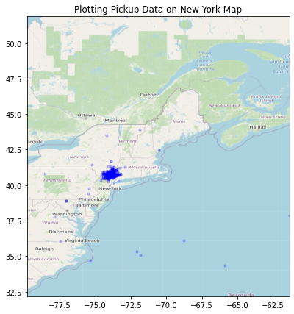
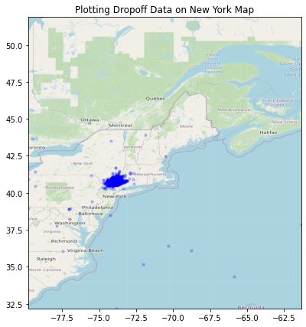
Answer Slide – Pickup, Dropoff Data
N
N
0
70
140 miles
0
70
140 miles

Slide 22
You notice that the dataset does not contain explicit data points out-of the-box, we’ll need to enrich the dataset with relevant fields:
You notice that ride price is not included, but figure it could be derived. Based on information about New York taxi prices gleaned from the internet, create a calculated field called `price` using the `duration`, `distance`, and `passenger count` fields.
You hypothesize your target users will be those who take a relatively longer time getting to a destination that is relatively close, due to heavy traffic conditions and/or limitations to physical road infrastructure. To be able to analyze where this is happening, you will need to create a calculated field called `distance-to-duration ratio`.

Slide 23
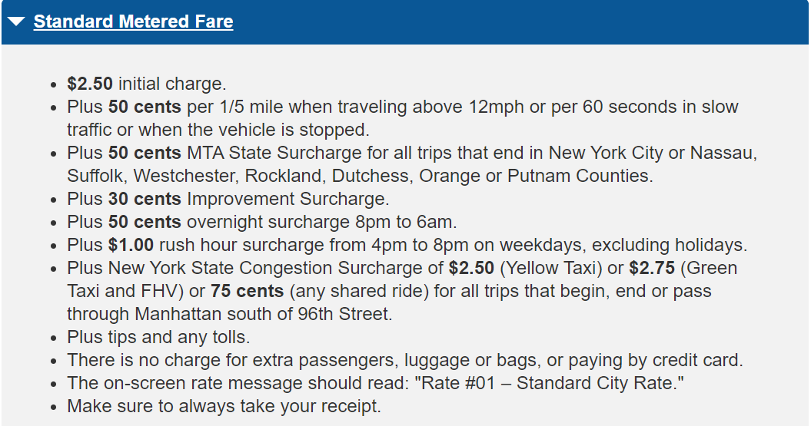
Source: www1.nyc.gov/site/tlc/passengers/taxi-fare.page

Slide 24
Let’s understand the scope and distribution various dimensions within the dataset. Calculate the average, median, and the first & second standard deviation of the mean for the following measures:
duration
distance
passenger counts
duration-to-distance ratio
price

Slide 25
Answer Slide
Here you have results for all 1 048 253 trips present in our dataset. In the next slide you have clean elaborated data. Everything is unrealistic so we need to clean up our data.
 | Original Duration | Distance in km | Duration to Distance Ratio | Price in USD
Count | 1048253 | 1048253 | 1048253 | 1048253
Mean | 962.31 | 3.44 | 86.00 | inf
Standard Deviation | 5853.84 | 4.10 | 102.62
Minimun | 1.00 | 0.00 | 0.00 | 0.52
25% | 397.00 | 1.23 | 30.81 | 201.62
50% | 662.00 | 2.09 | 52.37 | 281.38
75% | 1075.00 | 3.88 | 96.93 | 394.36
Maximum | 3526282.00 | 578.84 | 14471.07 | inf

Slide 26
Answer Slide
Here you have results for 1 041 861 remaining trips present in our dataset. In the next slide you have clean elaborated data. Everything is unrealistic so we need to clean up our data.

Slide 27
Answer Slide
Steps we have taken to clean up our dataset: Drop touristic trips, We will not be taking into consideration touristic rides, so we drop these 3504 trips starting and ending at the same place. Drop trips more than 100 km distance and less than 100 m Recalculate trip duration, assuming the technology we are exploring travels 4.3 km per minute let's calculate travel times assuming they travel 4 km/min Drop trips with duration more than 1 hour and 40 minutes. It looks reasonable not to take more than 6000 seconds for trip preparation. We will consider Original durations of more than 6000 seconds (100 minutes which is 1 hour and 40 minutes) as outliers and therefore not consider this into the analysis Create price field We will taking into consideration the most common answer from the previous analysis to start testing loops in order to lead a meaningful price both for us and competition. Create duration to distance ratio field

Slide 28
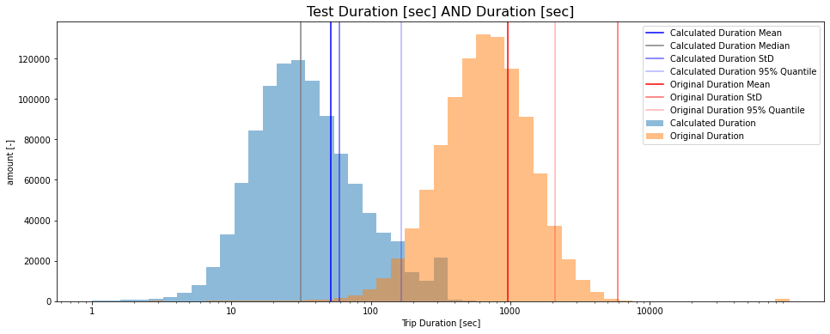
Answer Slide
It looks like we have approximately ten minutes for trip preparation (that is take off and landing)

Slide 29
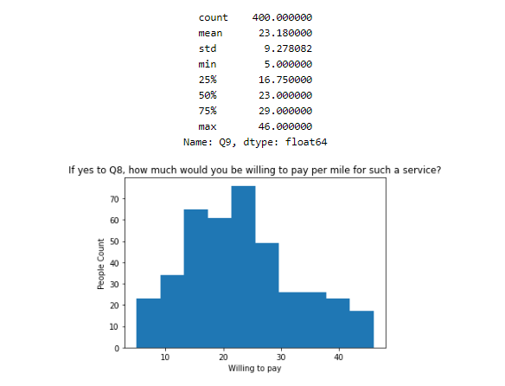
Answer Slide
I suggest 25 USD per mile to be a reasonable price plus 10 USD for the hiring service.
We need to develop further our technology to offer a meaningful service to handicap carriers

Slide 30
Flying cars may have to have to be a lower weight for efficiency & take-off. Or you may just decide to leverage mini-copters for your initial MVP.
Create a histogram that visualizes the number of total rides grouped by passenger counts to analyze the potential market volume of low passenger pickups (1-2 passengers).

Slide 31
For the initial MVP launch (& most likely GA), we have a finite amount of monetary resources to build Flyber pick-up / drop-off nodes. We’ll need to be strategic on where we’ll place them:
Which neighborhoods/zip codes tends to experience a relatively higher density of pick-ups?
Which neighborhoods/zip codes tends to experience a relatively higher density of drop-offs?
Which neighborhoods/zip codes tends to have the highest duration-to-distance ratios, based on pick-up?
Which neighborhoods/zip codes tends to have the highest duration-to-distance ratios, based on drop-off?
For any of the neighborhoods identified, are there any potential areas within the neighborhood that are optimal for flying taxi pick-up / drop-off? What makes them suitable?

Slide 32
Answer Slide
(Fill out your answer here) It looks like Manhattan is the most “on demand” borough with Pickup zip codes in most need: 10171, 10001, 10021 and Dropoff zip codes in most need 10199, 10131. Other Pick up and Dropoff zip codes in need are 11371, 11430. Buildings roof tops must be somehow transformed in order to comfortably become pick up and drop off points.

Slide 33
It may not make operational sense to have the service running 24/7, for now.
What times throughout the day experience relatively higher volumes of ride pick-ups?
What days throughout the week experience relatively higher volumes of ride pick-ups?
Pinpoint any periods throughout the year that experience trend fluctuation or seasonality around ride pick-up volumes. This will help us in our post-launch analyses to determine if any spikes or dips were influenced by seasonality or through actual feature adoption/regression.

Slide 34
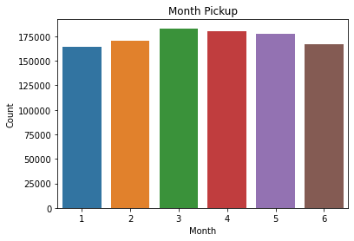
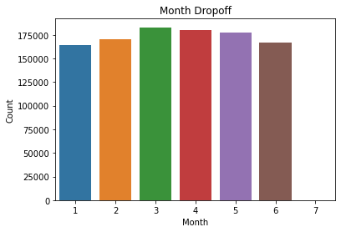

Slide 35
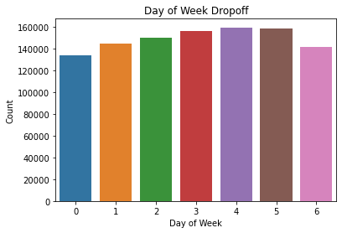
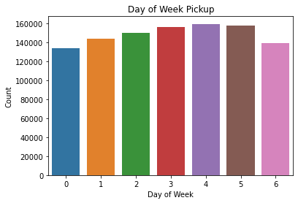

Slide 36
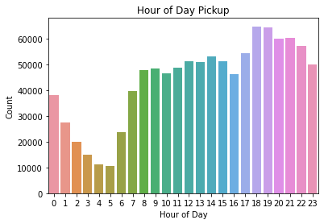
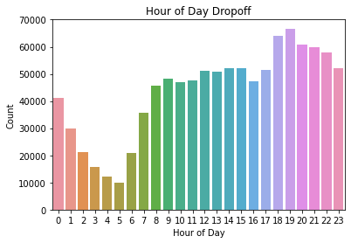

Slide 37
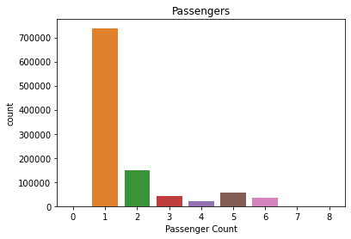

Slide 38
Answer Slide
(Fill out your answer here) During rush hour 17:00 – 20:00 PM are the most crowded moments of the day, weekdays seem to be more crowded with respect to Sunday. As for the month distribution a slightly higher demand in March is shown. Least crowded moments are from 3:00 to 5:00 am. Most trips are performed by one passenger.

Slide 39
You and the user research team ran a quantitative survey on existing taxi and/or rideshare users in New York City to determine sentiment around potentially using a flying taxi service.
Dive into the survey results dataset in order to extract insights from explicit feedback.
Upload this dataset into Tableau Online or a SQL database (the classroom contains a workspace with the data for you as well).

Slide 40
Ensure the fields are parsed correctly, field headers are included in the first row of the CSV.
Question schema:
Q1 - What is your email?
Q2 - What gender do you identify as?
Q3 - What is your age?
Q4 - What is your annual income? (income bands)
Q5 - What neighborhood do you reside in?
Q6 - Do you currently use taxis? (Y/N)
Q7 - Do you currently use ridesharing services? (Y/N)
Q8 - Would you use a flying taxi service, if such a concept existed? (Y/N)
Q9 - If yes to Q8, how much would you be willing to pay per mile for such a service? (USD)
Q10 - If no to Q8, what is the reason?

Slide 41
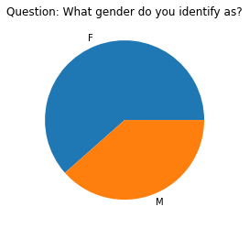

Slide 42
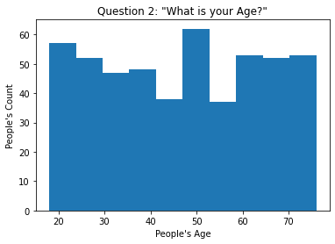

Slide 43
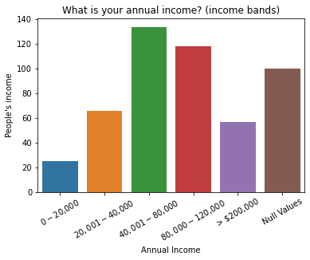

Slide 44
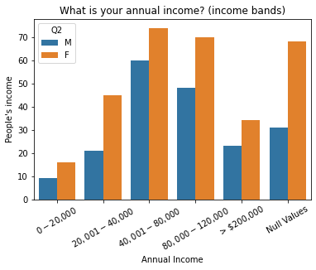

Slide 45
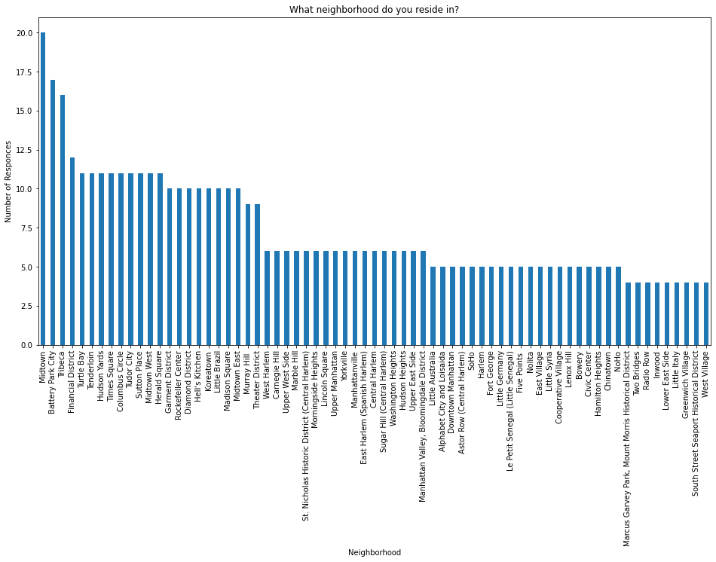

Slide 46
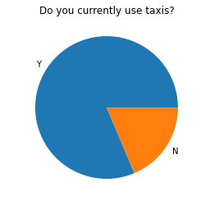

Slide 47
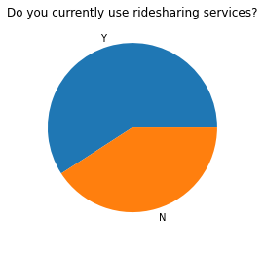

Slide 48
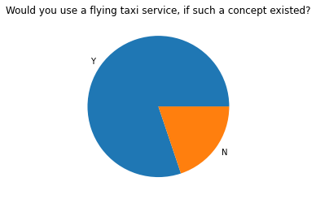

Slide 49
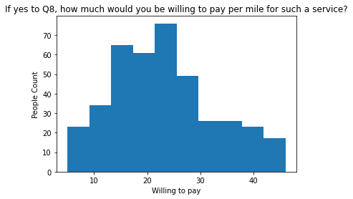

Slide 50
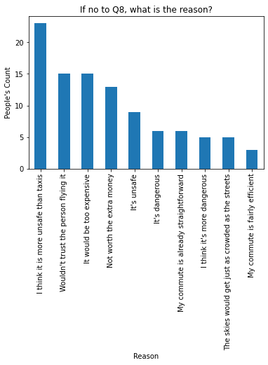

Slide 51
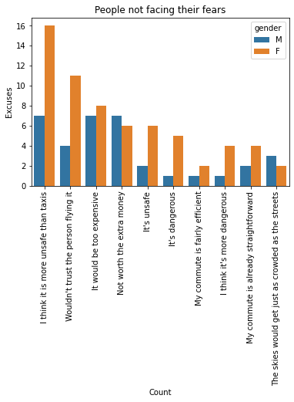

Slide 52
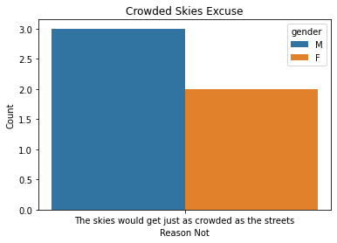
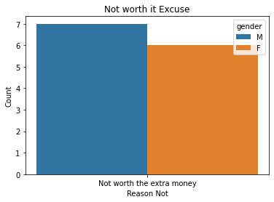

Slide 53
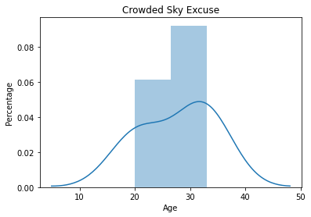
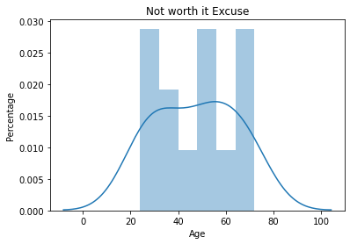

Slide 54
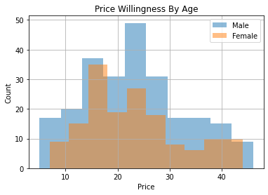

Slide 55
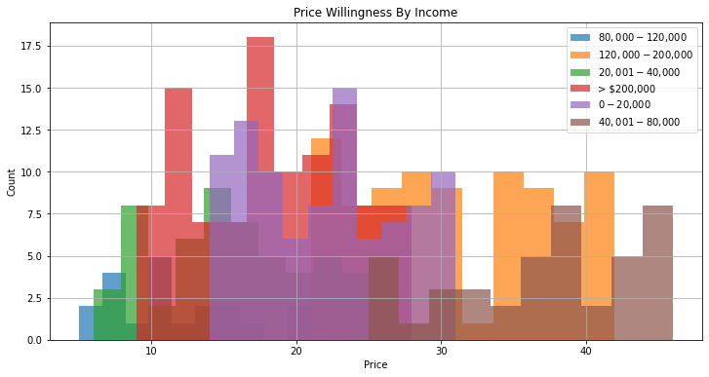

Slide 56
To inform our future product marketing efforts, we’ll want to extract the following:
Is there an inclination of better Flyber adoption based on gender, age, income level, or neighborhood of residence?
What is the distribution of potential price per mile based on gender, age, income level, and neighborhood of residence?
What is the different personas/segments of negative sentiment towards not using a flying taxi car service?

Slide 57
Answer Slide
(Fill out your answer here) It looks like 50-year-old women, living in Midtown, Batery Park City, Tribeca and Financial District making 40 000 to 80 000 USD (aka ‘expensive ladies’) have an inclination of better adoption. Distribution of potential price per mile is uniform with a pick for people around 50 years old, Manhattan residents. While ‘expensive ladies’ are convinced (!) about flying cars and most of them are ready to take the leap (!) they only have security concerns (or the commute challenge doesn't seem to be something they care about because they live very close to work or favorite shopping center) young men or men in general are yet to be understood. A comprehensive strategy must be put in place to get to know these poor young souls. Young men are concerned about “crowded skies” and men in general want to know if it does worth the money.

Slide 58
Hooray! End of Section 1.

Slide 59
You will complete Section 2 at the end of this course.
Please submit this file for review for Section 1.

Slide 60
Section 2: Proposal Synthesis

Slide 61
Identify a product objective for Flyber's launch. Your product objective will guide your KPIs, so identify what Flyber should optimize for. Your objective should be centered around one the following focus areas:
User Acquisition
User Engagement
User Retention
Profitability
Explain your reasoning. Include both why you feel your focus area is more relevant than the others for Flyber at this time of the product development cycle.

Slide 62
Answer Slide
We will be focusing on USER ENGAGEMENT: Social acceptance and Regulatory hurdle are the main issues for a similar actual project as shown here. So the question is what it is we can do with this technology today, envisioning the future. The answer is, given the hurdles exposed before, talk to people about the Product Vision so that it can gain the social acceptance it deserves.

Slide 63
Answer Slide
So product vision is GENERATE SOCIAL ACCEPTANCE for Flyber using three main key objectives: Develop 100 commercial vehicles as a Minimum Viable Product Time span: 6 months

Slide 64
Answer Slide
Key Objectives Reach out to 50 active users/day, capture their needs, and design a traffic batches model just for the MVP. Collect passive users' information FROM THE GROUND using Google glass augmented reality technology where people will be VIRTUALY exposed to the vision of 3 000 vehicles, 6 000 vehicles and 10 000 vehicles in the sky and get feedback. Create a side project to augment meteorological models using Computer Vision by analyzing cloud shapes for Disaster Risk Reduction and extreme phenomena or even wildfire detection (detect pyrocumulus, cumulonimbus or other cloud shapes to predict extreme weather or wildfires)

Slide 65
Formulate 3-5 Key Performance Indicators (KPIs), to measure if the product is heading towards the right direction based on your objective

Slide 66
Answer Slide
Active Users
Reach out to 500 subscriptions in 6 months
Design three different batch systems for 100 vehicles to submit to the FAA for approval
Passive Users
Reach out to 10 000 passive users in six months using Augmented Reality technology
Decide upon the esthetic and visual capacity upon data collected by passive users - Passive users are pedestrians that look up in the sky with google glass technology
Side Project
Develop the sensors and the technology for each vehicle
Draft three different subscription plans for testing.
Develop CV algorithm for cloud detection
Create funding partnerships for the development of the side project and its social impact for DRR – Disaster Risk Reduction

Slide 67
Create hypotheses around what thresholds your KPIs would need to hit in order to determine success

Slide 68
Answer Slide
Reach out to more than 500 subscriptions in 6 months Design three different batch systems for 100 vehicles to submit to the FAA for approval Draft three different subscription plans for testing. Passive Users suggest more than 5 000 vehicles in the sky Passive users see more than five vehicle batches in the sky Employ with sensors more than 10 vehicles for DRR Develop 97% accuracy model for cloud detection Create more than five funding partnerships for the development of the side project and its social impact for DRR – Disaster Risk Reduction

Slide 69
As the product manager, you make decisions based on the insights you extract, we’ll need to know the feature set we’ll include in the MVP to measure viability, while keeping operational expenditure under control:
What times/days of operation should the service run for?
How many pick-up / drop-off nodes should we have?
Where should the nodes be located?
Should we initially use copters or homegrown hardware?
Should the pricing be fixed or dynamic? At what rates?

Slide 70
Answer Slide
What times/days of operation should the service run for?

Slide 71
Answer Slide
What times/days of operation should the service run for? Weekdays, mainly afternoon hours to meet the needs of working parents with children at school and other activities.

Slide 72
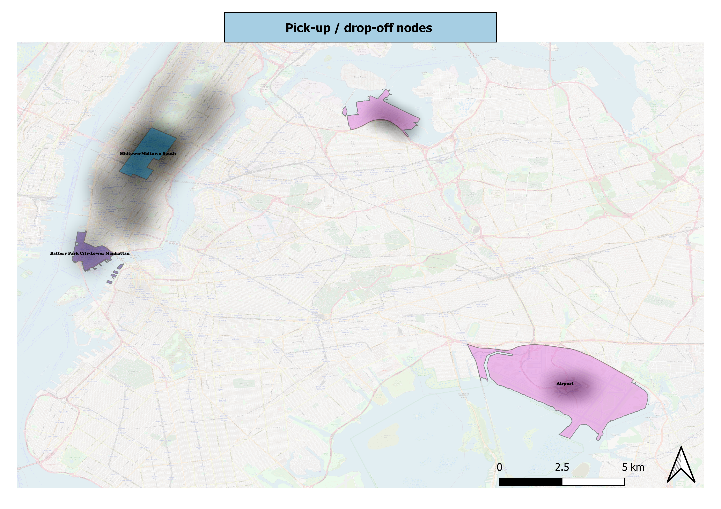
Answer Slide
Where should the nodes be located? Two nodes in Manhattan and one node for every airport as shown in the map below.

Slide 73
Answer Slide
Should the pricing be fixed or dynamic? At what rates? Dynamic at a rate the household can support. We are talking to 40 000 to 80 000 USD earning households.

Slide 74
Answer Slide
Should the pricing be fixed or dynamic? At what rates? Dynamic as follows. Source: https://www.investopedia.com/articles/personal-finance/021015/uber-versus-yellow-cabs-new-york-city.asp
Number of passengers | Description | Basic Fare | $/Minute + $/Mile | Minimum Fare
1 | Passengers with no specific needs | $2.55 | 0.35 $/Minute + 1.75 $/Mile | $7.00
2 | Passengers with no specific needs | $3.85 | 0.50 $/Minute + 2.85 $/Mile | $10.50
3 | Upscale Vehicles | $7.00 | 0.65 $/Minute + 3.75 $/Mile | $15.50
4 | Upscale Vehicles | $14.00 | 0.80 $/Minute + 4.50 $/Mile | $25.00
5 | Upscale Vehicles | $14.00 | 0.80 $/Minute + 4.50 $/Mile | $25.00

Slide 75
Answer Slide
Should we initially use copters or homegrown hardware? Copters should be initially used

Slide 76
Determine the MVP sample size & time period allotted estimated to come to a conclusion on your hypotheses.

Slide 77
Answer Slide
Develop 100 commercial vehicles in 6 months. We will be using these vehicles to design an experiment for 31 000 trips for our experiment, therefore approximately 5 167 trips per month to distribute in 100. Therefore every vehicle will have to perform 52 trips per month. This is less than 2 trips per day. However we think that generating 100 all together in the sky could be a valid way to visually create transportation batch design.

Slide 78
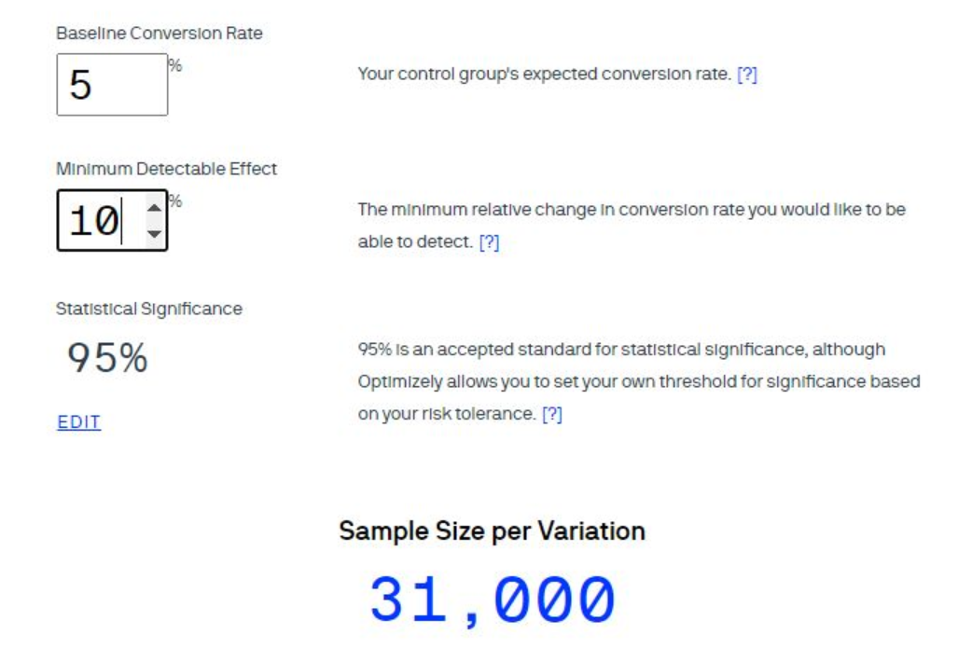
Answer Slide

Slide 79
Create an instrumentation plan for the events you need collected and logged, in order to be able to physically measure your KPIs.

Slide 80
Answer Slide
Deliver 10 vehicles to load the fleet every month until full completion. Load the fleet gradually. Develop the instrumentation for the side project in the first ten vehicles, test the technology along with DRR partner’s expectations. Here are the world’s top 10 reinsurance companies to use as partners for the side project plan. For the side project we collect: nubePercentage exremeRiskEventFlood extremeRiskEventWildfire For the transportation event we collect: user_id: “count of the number of both unique and repeated events a day will be used to determine this KPI” user_onboarding: “count of the number of userOnboarding events a day will be used to determine this KPI” onboarding_id: “count of the number of unique values will be used to determine this KPI” rideCompleted: “count of evacuated citizen events in case of emergency will be used”

Slide 81
Create a qualitative feedback survey questions for users after their ride, to further understand and optimize the product for future iterations.

Slide 82
Answer Slide
On a scale of 1 to 5, rate your experience using Fflyber: 1= least satisfied and 5= very satisfied. How likely are you to use Flyber again? How many times would you want to use Flyber in a week? On a scale of 1 to 5, how will you rate the technologies attitude during your ride? Did you enjoy the flight? Yes/Nein Was it romantic? Yes/Nein Did you think of your loved one? Yes/Nein Did you have a good view of the full moon? Yes/Nein

Slide 83
Summarize everything you have learned into your final proposal
Identify the target population. Why did you select that target population? What are their pain points?
Create a product proposal containing claim, evidence, estimated impact, and risks
Claims should be backed by quantitative evidence, impact should assess market needs/benefits
Risks involve any known unknowns that we’ll still need to monitor post-launch
State cross-functional stakeholder teams that will need to be involved

Slide 84
Answer Slide
Identify the target population. Why did you select that target population? What are their pain points? Data supports that households making 40 000 to 80 000 USD are mostly interested in our services. We need to support families with children at school as we envision educated customers.

Slide 85
Answer Slide
Create a product proposal containing claim, evidence, estimated impact, and risks Claim: Climate change is a real challenge for generations to come Evidence: Families with young children are struggling to balance their lives Estimated impact: with our proposal we stand by the needs of our future customers (children) by taking action against disasters to occur due to climate change Technological risk: our model for predicting extreme phenomena might not perform. Social Risks: we might not perform up to the needs of our target customer (families) because we do not have multi seat vehicles. Economic Risks: Partners might not get excited by our technology and solutions. Claims should be backed by quantitative evidence, impact should assess market needs/benefits Risks involve any known unknowns that we’ll still need to monitor post-launch

Slide 86
Answer Slide
State cross-functional stakeholder teams that will need to be involved Machine learning engineers for side project Sensor engineers for side project Augmented Reality designers for passive user’s project External Reinsurance support and expertise from Global organizations like the United Nations for Disaster Risk Reduction

